Slide 1
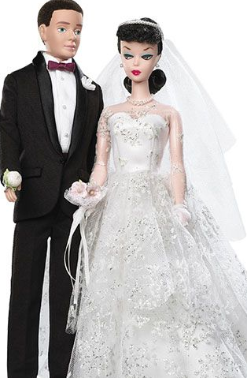
Speed Dating Experiment
What attributes influence the selection of a romantic partner?
Problem:
Analyzing gender differences in dating preferences from final outcome is difficult because a given correlation of attributes across partners is often consistent with underlying preferences.
Hypothesis:
Studying dating behavior using an experimental Speed Dating market where subjects are matched randomly creates variation in the number of potential partners and allows for direct observation of individual decisions rather than just final matches.
Data Set:
In this experimental paradigm, subjects meet a number of potential partners(between 9 and 21) for four minutes each, and have the opportunity to accept or reject each partner.
The main variable of interest is the Yes/No decision of each subject with respect to each prospective partner. This choice is supplemented with valuation of attributes (attractiveness, sincerity, intelligence, fun, ambition, shared interests). A pre-event survey provides additional information on subjects (self-reported) attributes.

